Slide 1

MOVIE TIME
Featuring an Exploration of Movie Data Over Time with Bonus Content

Slide 2
Movie Data Analysis
1
2
3
How has movie revenue and popularity changed over time?
Where are movies produced? What languages are used in the movies?
Can data be displayed non-numerically? When and why?

Slide 3
REVENUE AND BUDGET ANALYSIS

Slide 4
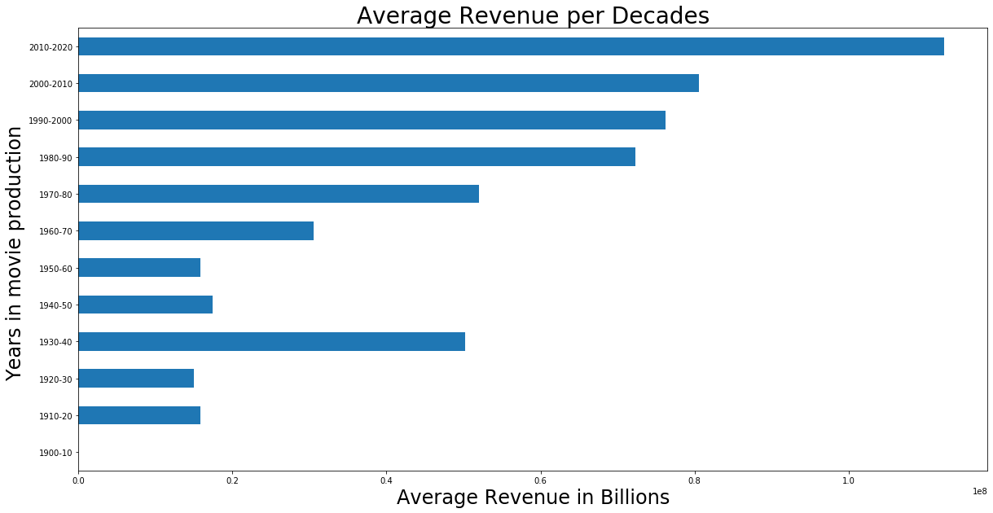
Average $ Revenue per Decade

Slide 5
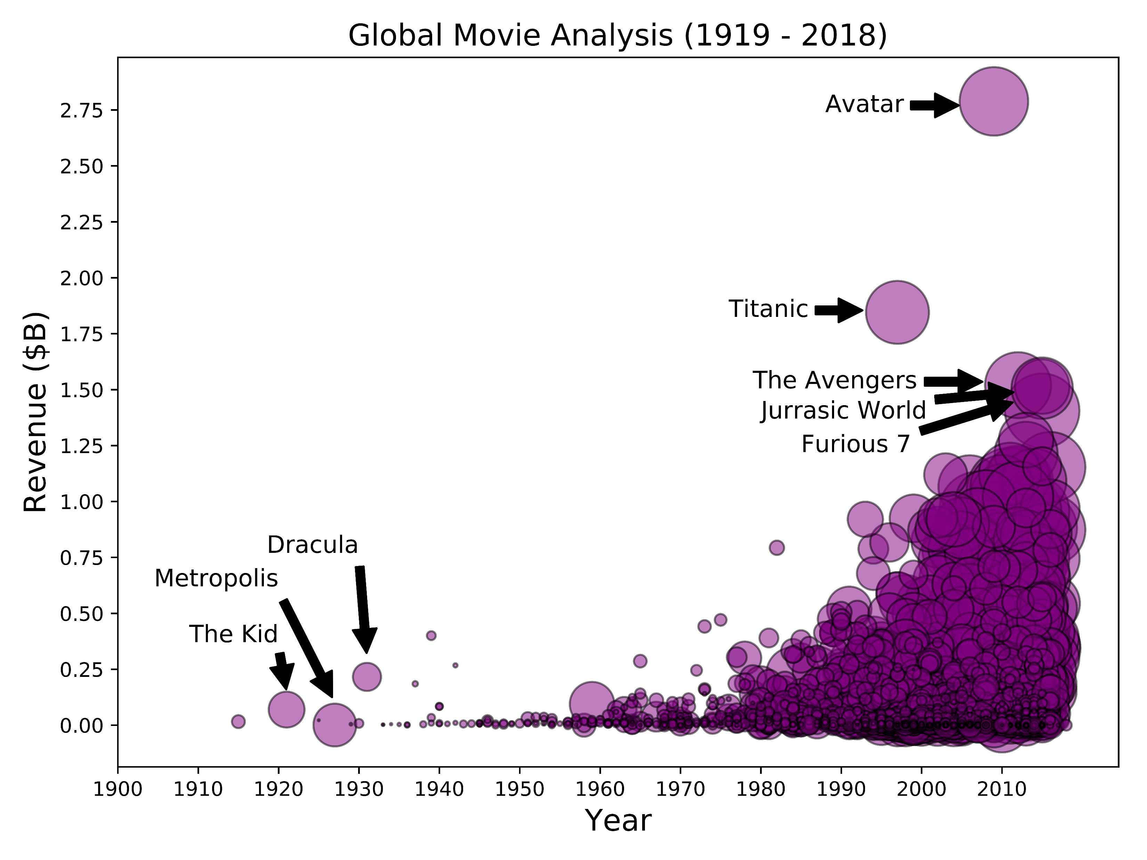




Global Movie Analysis (1919 – 2018)
Blockbuster Hits
Blockbuster Misses

Slide 6
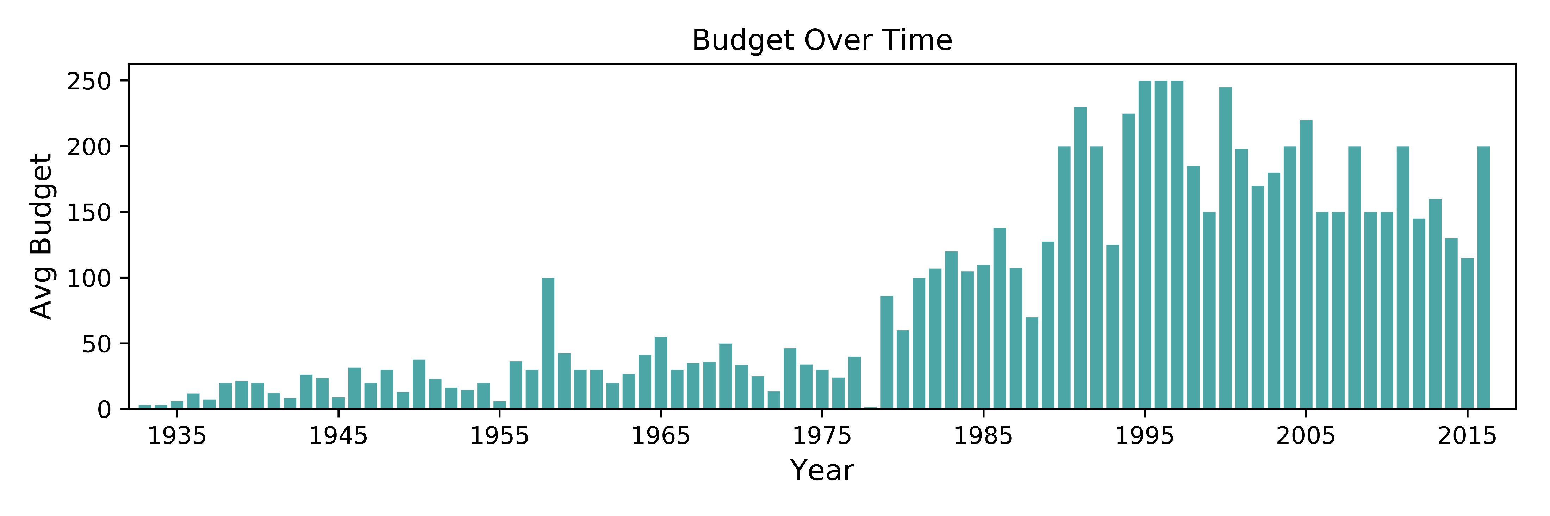
Budget Over TIme

Slide 7
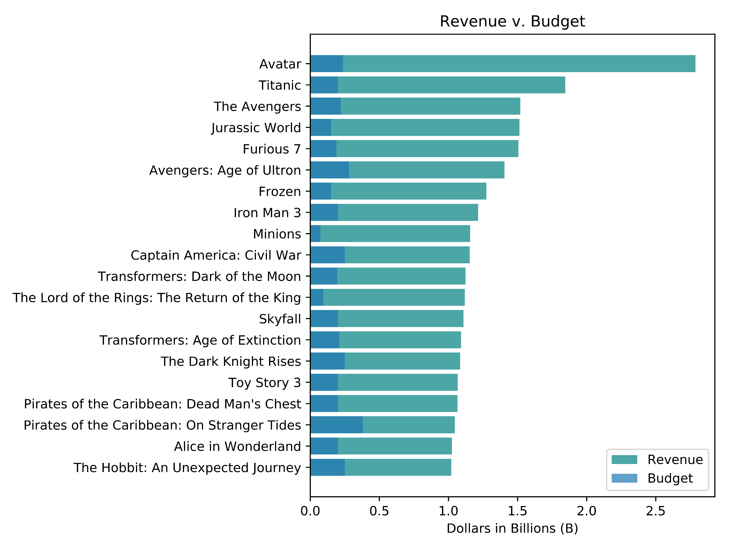

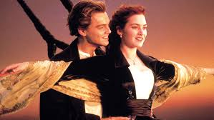

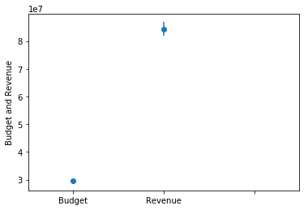
Revenue v. Budget

Slide 8

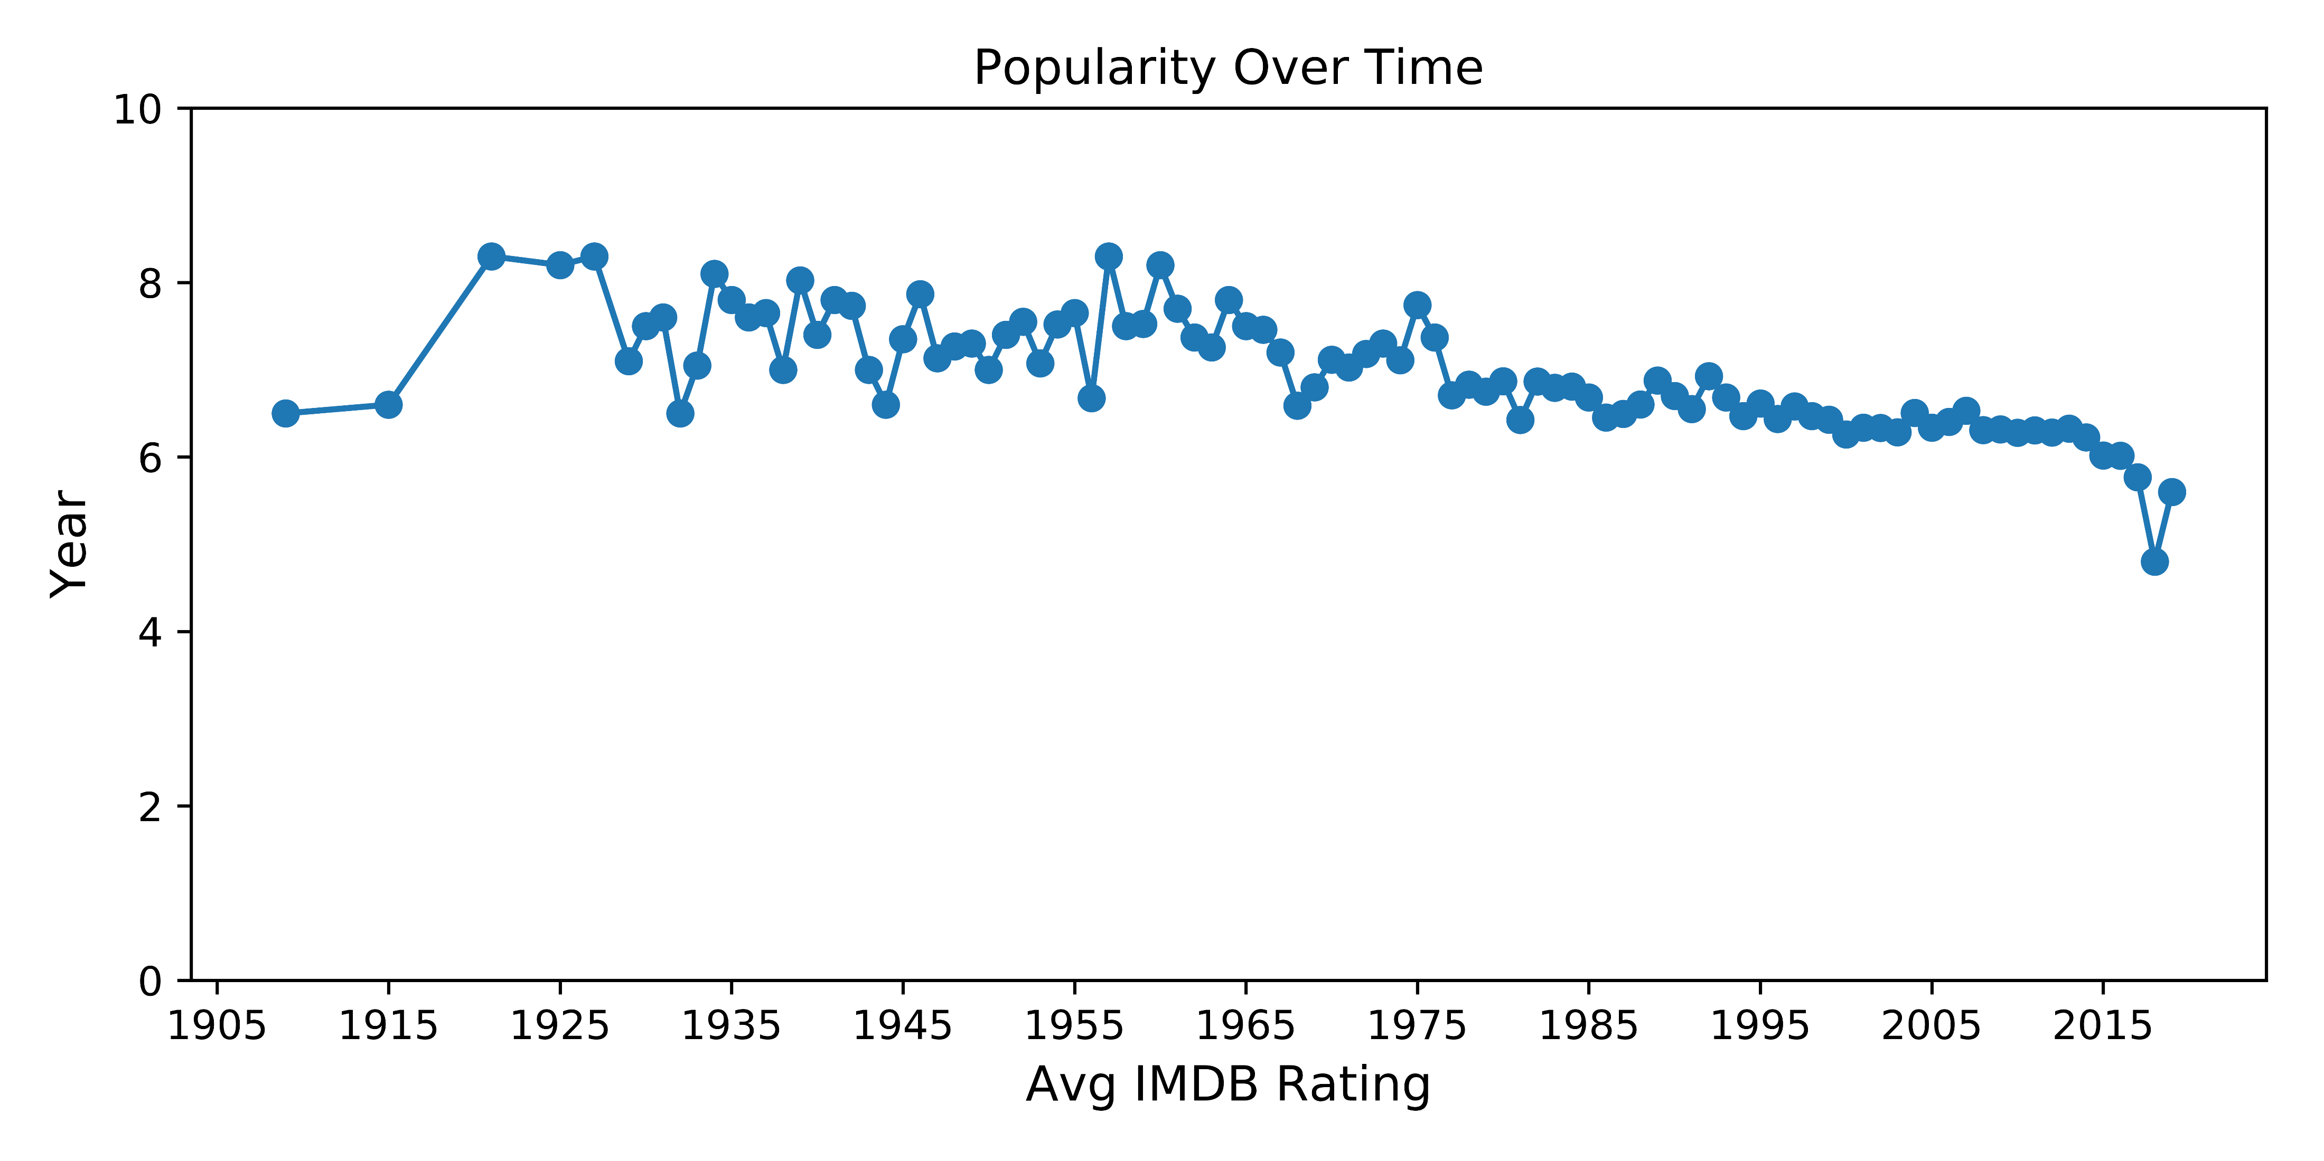
Popularity Over Time

Slide 9

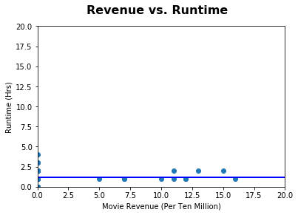

Revenue v. Runtime

Slide 10
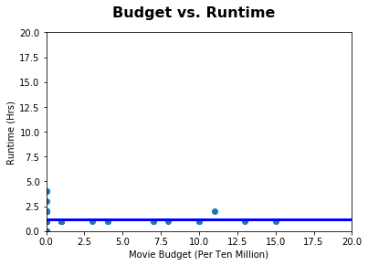

Budget v. Runtime

Slide 11
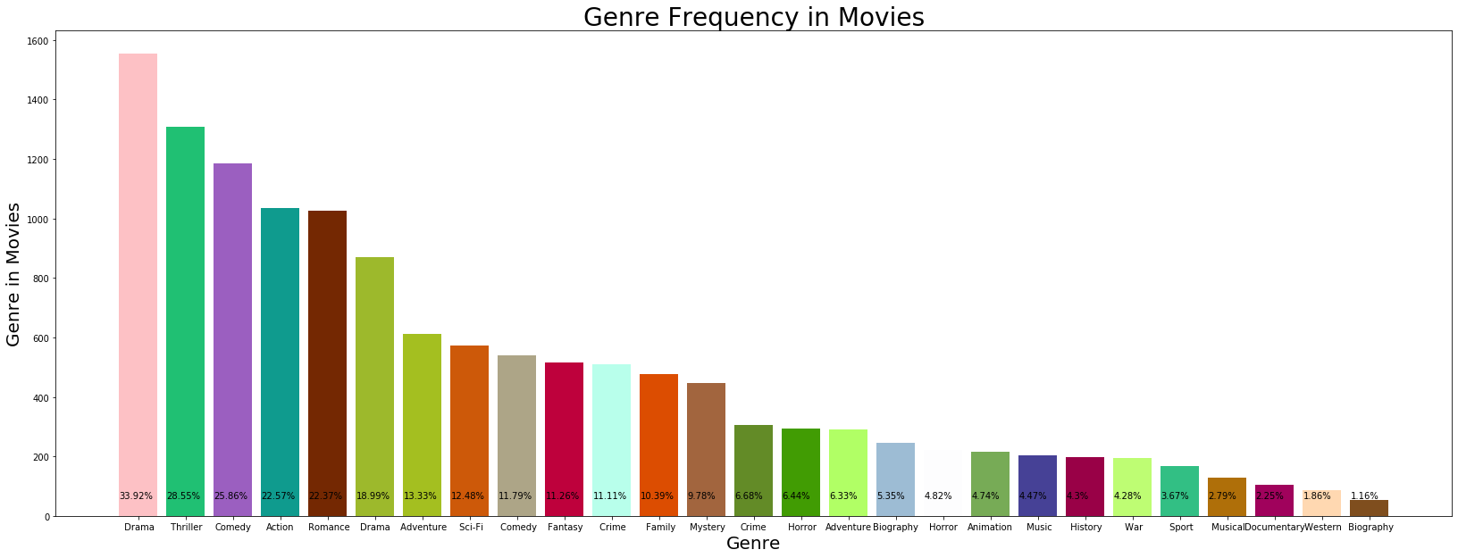
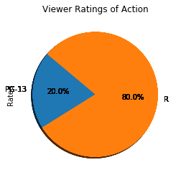
GENRE ANALYSIS

Slide 12
LANGUAGE ANALYSIS

Slide 13
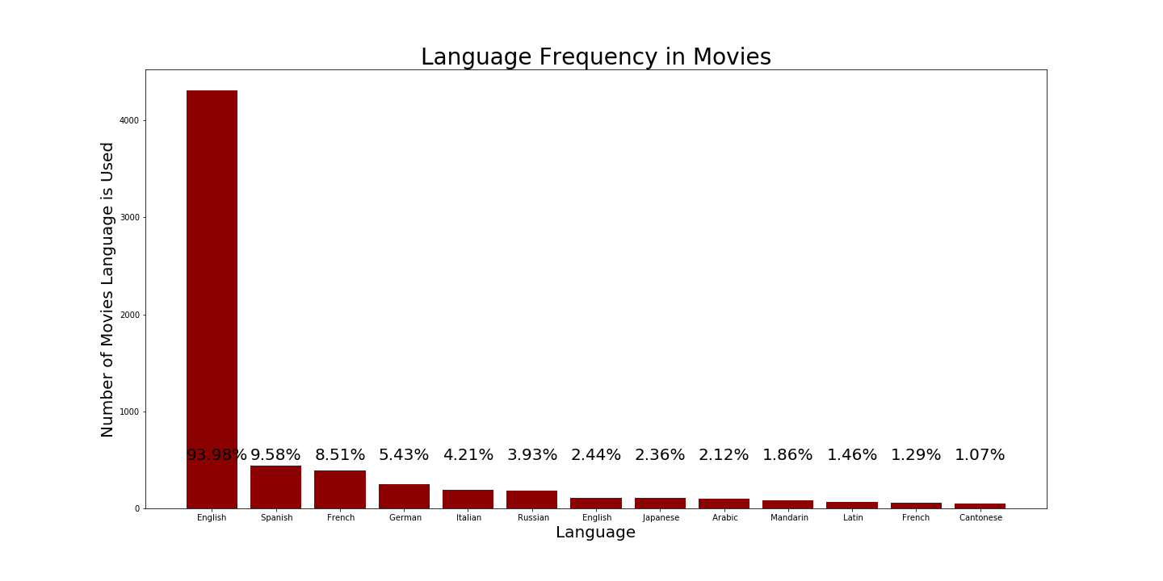
Language Frequency in Movies

Slide 14
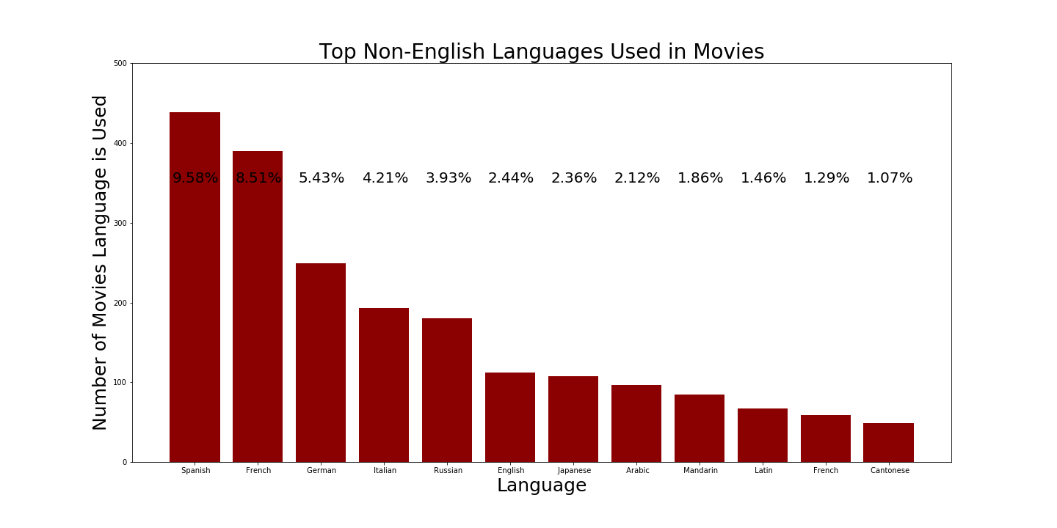
Top Foreign Languages Used in Movies

Slide 15
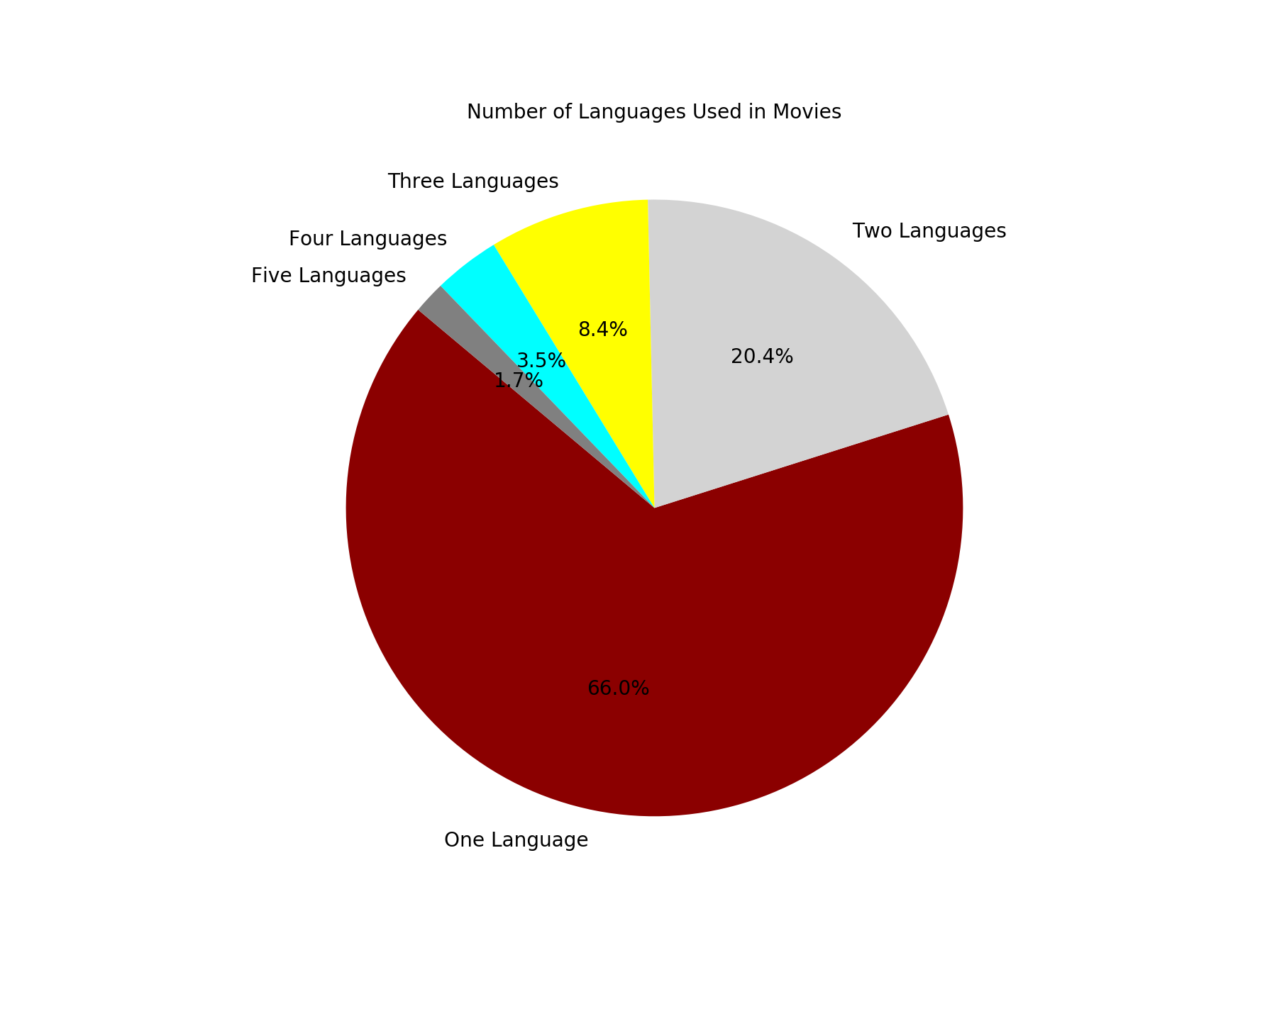
Number of Languages Used in Movies

Slide 16
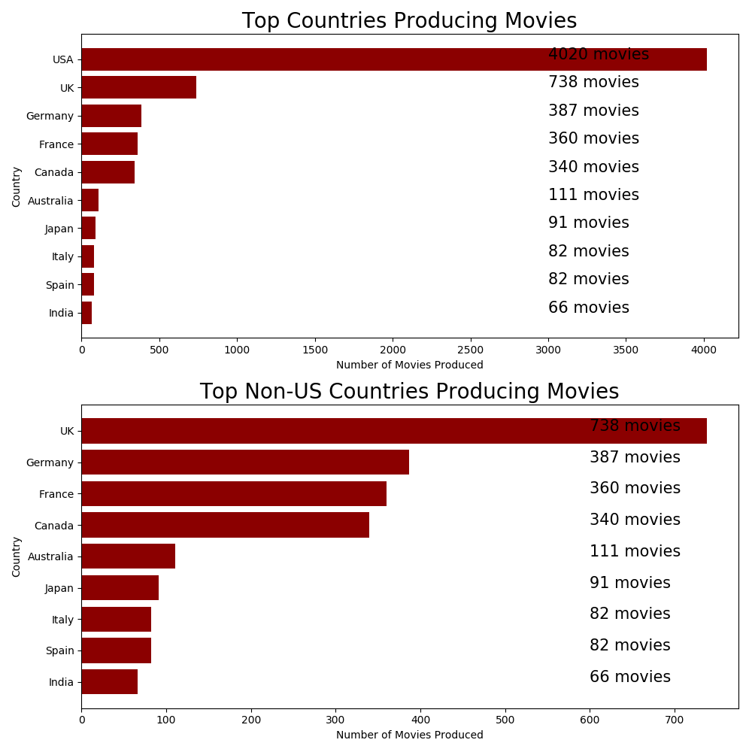
Top Countries Producing Movies

Slide 17
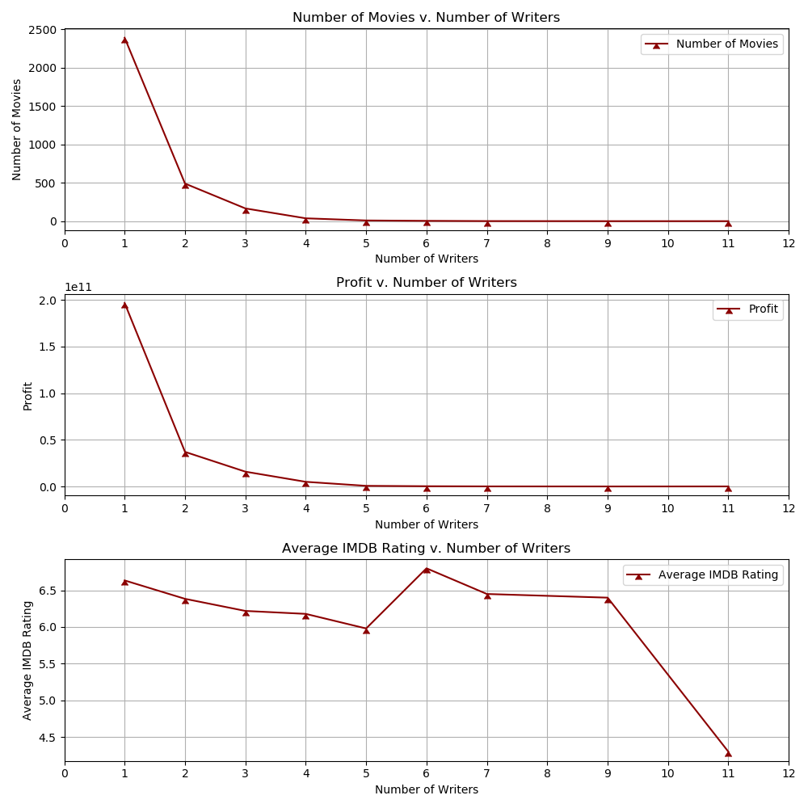
Number of Movies v. Number of Writers

Slide 18
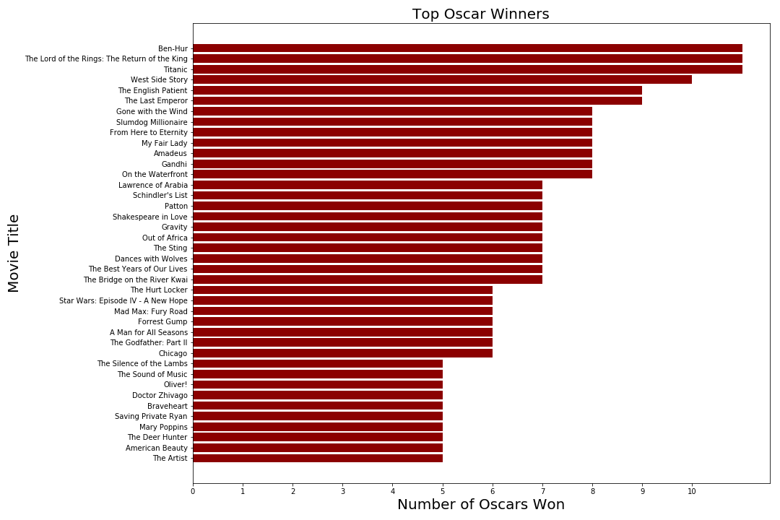
Top Oscar Winners

Slide 19


Language Frequency

Slide 20

Country Frequency

Slide 21


Genre and Title Frequency

Slide 22
Three Takeaways

